Slide 1
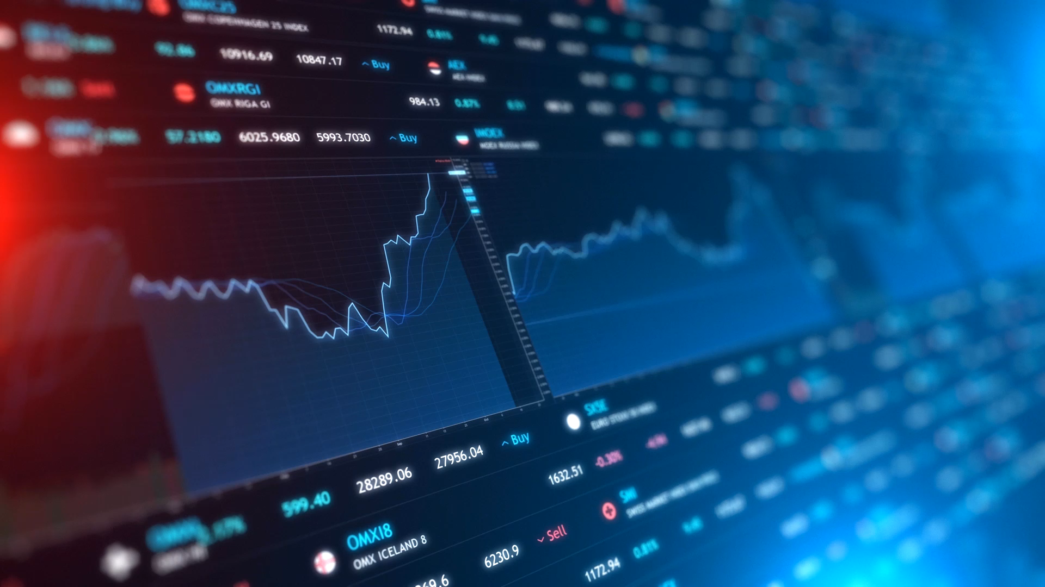

Action Recommendation System | ARS
ADSP 32019 Real-Time Intelligent Systems; Group 1

Slide 2
Agenda
Business Case & Goal
Product Overview
Under the Hood
Live Demonstration
Future Enhancements

Slide 3
Business Case | The Retail Investor
What is a Retail Investor?
Retail investors are non-professional individuals who invest their own money through brokerage accounts
How do they decide when to buy and sell stocks?
Common Manual Approaches:
General research of specific stocks’ historical performance
News sentiment analysis
Potentially some basic level of analysis
Gut feel

Slide 4
Business Case | The Goal
Can we make it easier for the retail investor to make trading decisions?
The Goal:
Develop a proof-of-concept alert system that provides a buy/sell signal for a tracked stock when appropriate conditions are met
Integrate some of the methods that investors currently employ, as well as some more advanced modeling, implemented in an automated and real-time system

Slide 5




Product Overview | Framework Diagram
Select stocks to track (i.e. MSFT)
Recommendation:
“Buy”
Investor
t=t+1
t=0
Decides Signal
60 Seconds
Server/Client
Black Box Model

Slide 6
Model Overview
Moving Average Crossover
ARIMA
Momentum Indicators
News Sentiment Analysis

Slide 7
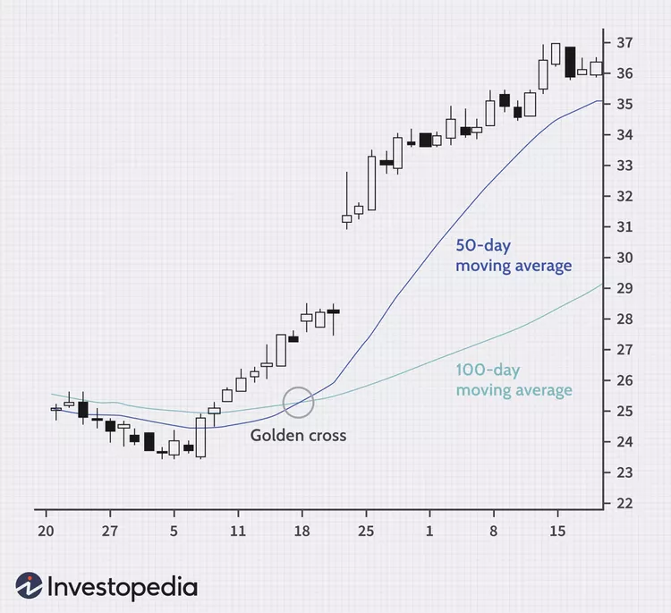
Model Overview| Moving Average
Every 60 seconds:
The latest 50 periods (minutes) MA is calculated
The latest 200 periods (minutes) MA is calculated
MA Scenarios:
50-min MA > 200-min MA ➔ Bullish
50-min MA < 200-min MA ➔ Bearish
No consistent change in direction
If cross occurred:
(A); signal sent to Buy
(B); signal sent to Sell
(C); signal sent to Hold
50-min MA
200-min MA

Slide 8
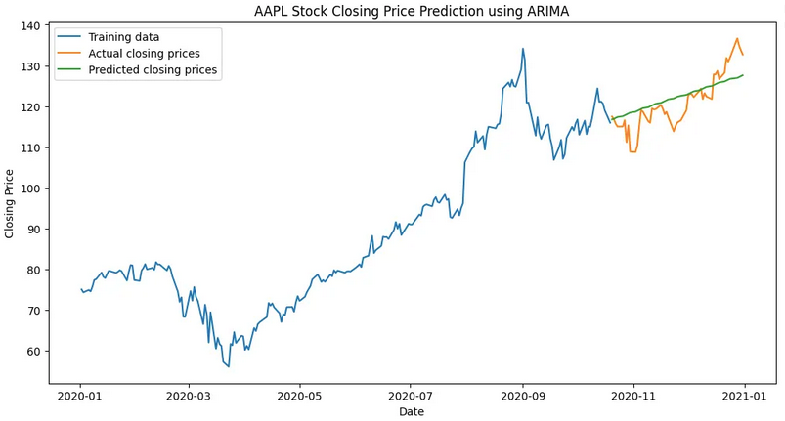
Model Overview| Auto-ARIMA
Every 60 seconds:
Auto-ARIMA model is fit to a tickers historical data
Prediction is calculated for the next period
The prediction is compared against the actual
Threshold set at 1%
Signal:
If threshold beat, send “Buy”
If not, “Hold”
Image source: https://medium.com/@matthew1992/arima-vs-lstm-a-comparative-analysis-of-time-series-forecasting-for-stock-price-prediction-4a765fe0e0ec

Slide 9
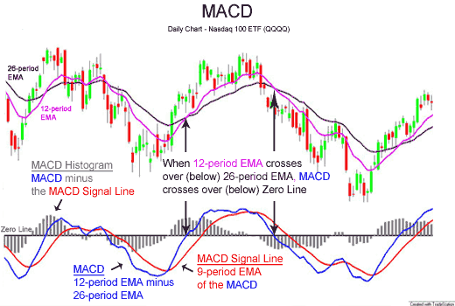
Model Overview| Momentum Indicators
Momentum indicators are technical analysis tools used to determine the strength or weakness of a stock's price. Momentum measures the rate of the rise or fall of stock prices.
These indicators are popular among day trading retail investors
Aggregate trading into 15-minute periods

Slide 10
Model Overview| Momentum Indicators
Moving Average Convergence/Divergence (MACD)
Primary Indicator
Exponential moving averages highlight recent changes in a stock's price. By comparing EMAs of different lengths, the MACD series gauges changes in the trend of a stock. The difference between the MACD series and its average is claimed to reveal subtle shifts in the strength and direction of a stock's trend.
Average Directional Movement Index (ADX)
The ADX is a combination of two other indicators developed by Wilder, the positive directional indicator and negative directional indicator. The ADX combines them and smooths the result with a smoothed moving average.
Commodity Channel Index (CCI)
The CCI is calculated as the difference between the typical price of a commodity and its simple moving average, divided by the mean absolute deviation of the typical price.
Relative Strength Index (RSI)
It is intended to chart the current and historical strength or weakness of a stock or market based on the closing prices of a recent trading period.

Slide 11
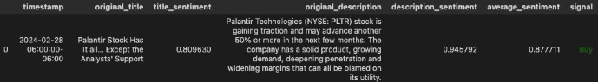

Model Overview| News Sentiment Analysis
Generate news data from Yahoo and Bing using their News Search APIs
Preprocess texts (tokenization, lemmatization, or remove stopwords)
Implement a pre-trained FinBERT model
Evaluate News Sentiment Analysis
News Table Sample:

Slide 12
Model Overview| Diagram Refresher
Select stocks to track (i.e. MSFT)
Recommendation:
“Buy”
Investor
t=t+1
t=0
Decides Signal
60 Seconds
Server/Client
Black Box Model

Slide 13
Model Overview| Black Box → Ensemble
Investor
t=0
Sentiment
“Buy”
Auto Arima
“Sell”
Majority Vote:
“Buy”
Momentum
“Buy”
t=t+x
MA
“Buy”
Ensemble

Slide 14
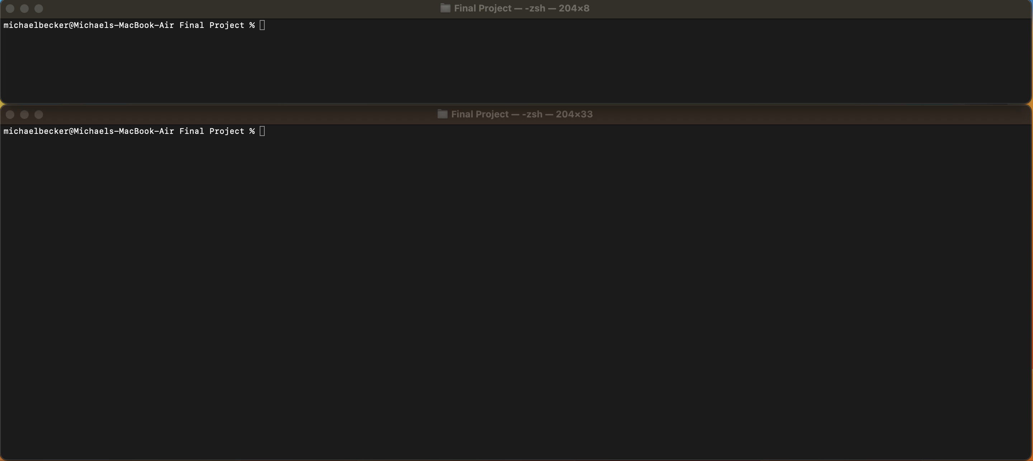
Live Demonstration

Slide 15




Actionable Recommendations
External Resources
Better Interface
Ethical AI Focus
More AI
Incorporate more robust source for real-time news data (e.g., Tweets)
Creation of GUI for more pleasing user-interface
Experimentation with UDP server connections to speed up prediction
Adopt transparent, research-backed methods to ensure ethical AI practices.
Additional back-testing and model tuning
Implementation of trade execution in program so trades can be executed automatically

Slide 16
Team
Michael Becker
Hyojun Kim
Bill Kluender
Utsav Thota
| mbbecker33@uchicago.edu
| kimhyojun@uchicago.edu
| bkluender@uchicago.edu
| uthota@uchicago.edu

Slide 17
Product Overview | How It Works
1. User identifies stock(s) to monitor
2. Minute-by-minute stock history is streamed in server every 60 seconds
3. Various models are trained
4. Each model is then used in real time to establish buy/sell/hold signal
5. Voting majority ensemble provides final recommendation
6. Models employ continuous learning throughout tracking process, retraining every 60 seconds

